Slide 1


Slide 2
Peer-on-Peer Online Sexual Abuse in the School Context
Virginia Soldino, PhD
University Research Institute of Criminology and Criminal Science
University of Valencia
Ljubljana, 21/5/2025
Notes:
Today I’m speaking about the importance of Peer-on-Peer Online Sexual Abuse in current adolescent and educational contexts. I’ll try to explain this phenomenon considering the intersection of development, peer influence, and digital environments in shaping risky or abusive sexual behaviors online.

Slide 3
Why This Matters
Adolescence = critical stage for sexual identity
Peer dynamics influence behavior
Technology reshapes social interaction
Increased exposure to online victimization
Notes:
Adolescence is a critical developmental period marked by significant physical, emotional, and social changes. During this stage, adolescents navigate the challenges of managing and regulating their sexual attraction and impulses in alignment with societal and cultural norms, making adolescence the critical stage for the construction of their sexual identities.
Moreover, the important influence of peer groups during this stage plays a critical role in normalizing and perpetuating abusive behaviors within social dynamics.
Nowadays, digital technologies have transformed adolescent social interactions, making online platforms central to their daily lives. This connectivity offers positive opportunities for communication and exploration, but it also exposes adolescents to the risk of online victimization.

Slide 4
What Is Peer-on-Peer Online Sexual Abuse?
Non-consensual sexual behaviors between peers
Facilitated via digital platforms
Includes sexting, sextortion, image-based abuse
Often overlaps with face-to-face harassment
Notes:
The anonymity of digital platforms reduces barriers to harmful behaviors, amplifying online risks. This environment allows individuals who might not participate in face-to-face bullying or sexual violence to perpetrate harmful actions, such as sending unsolicited explicit messages, sharing non-consensual sexual content, or posting degrading comments about a peer's appearance or sexual behavior.
Research highlights a significant overlap between traditional face-to-face bullying, sexual violence and online sexual victimization, complicating the landscape of adolescent peer interactions. This continuity of victimization intensifies the harm and adverse outcomes for victims.

Slide 5
Technology-Facilitated Sexual Violence (TFSV)
Use of digital tools to perpetrate sexual violence
Non-consensual image sharing (IBSA)
  “Deepfakes," unsolicited sexts,…
Coercion via digital channels
Often occurs in relationships (e.g., cyber-dating abuse)
Notes:
Technology-facilitated sexual violence (TFSV) includes diverse ways in which harmful sexually aggressive or harassing behaviors are being perpetrated with the aid or use of digital communications technologies.
These behaviors often include nonconsensual creation, distribution, or sharing of intimate images, such as nude or sexual photos or videos; commonly categorized as image-based sexual abuse. This phenomenon extends to actions such as pressuring or coercing individuals to share intimate content, sending unsolicited explicit material, or manipulating images to produce digitally altered content that sexualize classmates like "deepfakes".
When occurring within intimate relationships, such behaviors are classified as cyber-dating abuse, a technology-facilitated form of intimate partner violence.

Slide 6
Non-Consensual Sexting
Unsolicited content (“cyberflashing”)
Forwarding without consent (revenge porn)
Coercion and manipulation
Role of peer validation and social pressure in forwarding harmful content
Emotional and reputational consequences
Notes:
While consensual sexting is often considered a normative behavior among adolescents in romantic or sexual relationships, non-consensual sexting encompasses various behaviors, including the unsolicited sending and receiving of sexually explicit content (also known as “cyberflashing”), the unauthorized forwarding of sexts to others (also known as “revenge porn”), and pressuring, coercing, or threatening individuals to share intimate images (also known as “sexting coercion”).
In the school context, youth may forward sexts without consent for various reasons, such as seeking revenge, causing reputational harm, boasting about sexts received, social validation, or just for fun.
These actions can have severe social and emotional consequences, often amplifying bullying, peer pressure, and exclusion.

Slide 7
Sextortion Among Adolescents
Threats to share explicit images unless demands are met
Strong links with poly-victimization
71% of sextortion victims are under 18 (Wittes et al., 2016)
Often perpetrated by known peers
Adolescents may be both victims and perpetrators (cycle of abuse)
Gender & sexual identity factors:
  Boys more likely to offend
  LGBTQ+ youth more vulnerable
Notes:
Sexual extortion involves threats to share nude or sexual images to manipulate victims into complying with specific demands, such as providing additional intimate content, engaging in unwanted acts, or paying financial ransoms.
These incidents may precede, occur alongside, or result from various forms of in-person abuse, and may also escalate into the actual dissemination of images, increasing the risk of multiple or poly-victimization
Some studies highlight alarming trends. For example, an analysis of cases reported in the US revealed that 71% of sextortion victims were under the age of 18.
We also know that sextortion among school-aged youth is often perpetrated by individuals known to the victim rather than strangers, such as classmates, friends, or intimate partners.
Studies have identified a strong correlation between victimization and perpetration, particularly among males, suggesting a cycle of abuse.
Gender and sexual identity also influence sextortion patterns. Boys are more likely to perpetrate sextortion while sexual minority adolescents appear particularly vulnerable to sextortion both as victims and perpetrators.

Slide 8
Consequences for the School Environment
Creates a hostile, unsafe atmosphere
Undermines trust and peer support
Affects victims’ academic performance, mental health
Challenges for teachers and administrators
Notes:
Peer-on-peer TFSV often involves a significant victim-offender overlap, with one form of abuse serving as a "gateway" to others. Such abuse not only impacts on victims' privacy and autonomy but also cultivates a hostile and unsafe educational environment, often resulting in long-lasting psychological, social, and academic consequences.

Slide 9
What Can Schools Do?
Educate on consent, digital ethics, legal consequences
Peer-led and bystander programs, student empowerment
Safe, anonymous reporting systems
Restorative practices & supportive environments, trauma-informed approaches
Notes:
Preventing peer-on-peer online sexual abuse requires a targeted approach that addresses the sexual nature of these behaviors, moving beyond general cyberbullying prevention. Key topics for intervention include consent, distinguishing healthy online interactions from abusive ones, the risks associated with sexting, and the legal implications of sharing explicit material.
Peer-led and bystander programs have proven effective in preventing sexual harassment, equipping students with the knowledge and skills to intervene safely when witnessing or suspecting online sexual abuse.
Victims of sexual harassment often trust peers rather than adults, with many failing to report their experiences. Adolescents may also fear retaliation or feel that reporting will not result in a positive outcome. In this context, effective prevention and intervention strategies must address these barriers by fostering supportive environments and empowering students to seek help.
Restorative practices focused on rehabilitation, rather than punishment, can help promote empathy and accountability. Additionally, specialized, trauma-informed training for educators and parents may be crucial.

Slide 10
Collective responsibility and coordination across institutions
Partnerships with tech platforms, law enforcement
Teachers = trusted adults
Parents need digital literacy and communication tools
Counseling and support services for victims
Notes:
Effective prevention requires collaboration among schools, technology companies, law enforcement, and online safety organizations.
Educators, as trusted adults, are in a unique position to help students identify TFSV, offer emotional support, and guide them through the reporting process. On the other hand, parents and caregivers must also play an active role in managing digital risks and creating supportive family environments that promote healthy development and open communication .
Equally important are support systems for victims. Counseling and rehabilitation programs tailored to the needs of those affected by TFSV are essential for recovery.

Slide 11
Conclusion
Online sexual abuse among peers is real and rising
Move beyond reactive responses
Tailored, evidence-based interventions are needed
Early education and reporting mechanisms are key
Let’s work toward safer digital spaces for all students!!
Notes:
In conclusión, we must be aware that online sexual abuse among peers is real and rising and we need to move beyond reactive responses. Tailored and evidence-based interventions are needed, as well as early education on this matter and safe reporting mechanisms. So please, let’s work together toward safer digital spaces for all students!!

Slide 12

Contact
virginia.soldino@uv.es
Updated publications
https://www.researchgate.net/profile/Virginia-Soldino
Virginia Soldino

Slide 13
School Bullying in Japan: current situation and preventive/interventive measures
Hiromichi Kato, Shu Yue
Faculty of Education, Hokkaido University
Ljubljana, 21/5/2025
Notes:
Hello, Everyone.
Thank you very much for inviting me today.
I’m honored to be here.
My name is Hiromichi Kato. I come from Hokkaido, Japan. Hokkaido is located in the northern part of Japan. I’m interested in the development of puberty and problematic behavior during this period. I come here with my three colleagues.
They also study about school bullying from their own perspectives. I hope they would communicate with you in this conference.
Today, I’d like to talk about the current situation of bullying in Japan and share one example of how we are dealing with it.

Slide 14
Outline
The Current Situation of Bullying in Japan
Issues in Addressing Bullying in Japan
An example of Intervention against Bullying
Notes:
There are three topics I’d like to talk about.
First, I will talk about the current state of bullying in Japan.
Next, I will talk about the issues in Japan’s anti-bullying measures.
Finally, I will introduce the approaches we have taken to intervene in bullying and the outcomes to overcome these issues.

Slide 15
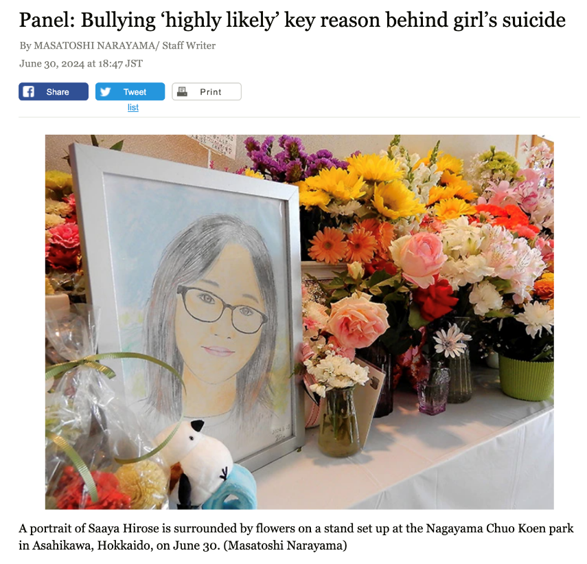
Current situation
Suicide is the leading cause of death among teenagers in Japan.
The leading cause of suicide among teenagers is school-related issues.
Notes:
At first, I will talk about the current bullying situation in Japan.
This photo is of a girl who died by suicide in 2021 as a result of bullying. She was 14 years old.
Before she died, she had suffered not only from traditional forms of bullying but also from repeated sexual abuse from other students. She had even attempted suicide multiple times, and her teachers were aware of this. But they were still unable to improve the situation and prevent her death.
After her death, these facts were reported by the media, leading to intense criticism of the school and the teachers’ response. The case became a symbolic bullying incident that drew nationwide attention in Japan.
Back to the topic.
Suicide is the leading cause of death among teenagers in Japan. The leading cause of suicide among teenagers is school-related issues.
And school-related issues might include bullying.

Slide 16
Current situation
the Act for the Promotion of Measures to Prevent Bullying (APMPB)
1. Establish basic policies for responding to bullying cases at each school.
2. Respond to bullying through a school-wide team,
not by individual teachers.
3．A third-party committee must investigate serious cases.
Notes:
The Japanese government established a law on school bullying to address this serious situation.
To summarize the key points of this law:
1. Each school must establish basic policies for responding to bullying cases.
2． Teachers should respond to bullying as a team, rather than individually.
3． In the case of a serious incident that poses a threat to a student’s life, an investigation must be conducted by a third-party committee.
The third-party committee is the investigative team comprising experts not affiliated with the school. I was a committee member in Sapporo city and am now the chairman.

Slide 17

Issues
When investigated by a third-party committee….
There was no organized response; only the homeroom teacher handled the case individually.
In Japanese schools, each class is assigned a homeroom teacher, known as a tannin. Unlike in many Western countries, the homeroom teacher is not only responsible for teaching a subject but also manages students’ daily life and behavior.
Bullying is underestimated as a minor student issue, resulting in it being ignored.
Notes:
However, when we examine schools where serious bullying incidents occurred…
There was no organized response. Only the homeroom teacher handled the case individually.
The homeroom teacher may be a unique system in Japanese education.
In Japanese schools, each class is assigned a homeroom teacher, known as a tannin. Unlike in many Western countries, the homeroom teacher is not only responsible for teaching a subject but also manages students’ daily life and behavior, conducts morning and afternoon homerooms, provides personal guidance and emotional support, and communicates regularly with families. And they often stay with the same class for a whole year (or more)
In some cases, bullying is often underestimated as a minor student issue based on the judgment of a single homeroom teacher, resulting in it being overlooked or ignored.
Why does this happen?

Slide 18

Why does this happen?
Paper-based survey
It is difficult for teachers to share information about bullying cases.
Paper surveys took days to process, delaying interventions even further.
Notes:
We believed that one of the causes was the use of paper-based surveys.
Because paper-based surveys require checking a large number of questionnaires one by one, it is difficult for teachers to share information about bullying cases among teachers.
Because teachers had to manually collect and check each paper, it took time to respond to bullying cases
Japanese media reported that teachers are becoming busier and busier and most teachers are working overtime above the death line of overwork. Thus checking the questionnaire is big task for teachers and they sometimes misunderstood the bullying situation.

Slide 19
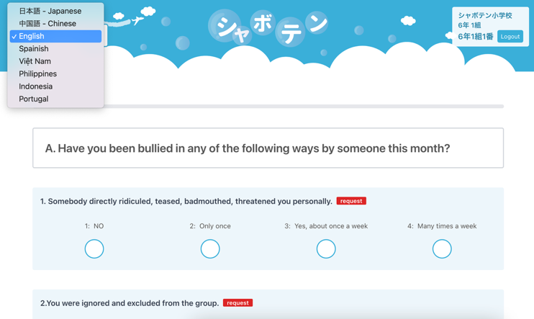
Intervention
Introduction of a Bullying Risk Assessment App
Figure 1 Student Interface: Questionnaire on Bullying
Note:
Available in 8 languages
Usage Status:
Municipalities: 5 cities
Number of students: Approx. 230,000
Number of schools: Approx. 500 schools
Notes:
So, to address these issues, we developed a School Bullying Risk Assessment App and introduced it in schools.
Figure 1 is the student interface.
Students use tablets to answer questions about whether they have experienced bullying, where and when it happened, and the current status of the resolution.
Currently 5 hundred schools in 5 cities and 2 hundred 30 thousand students use this application.

Slide 20
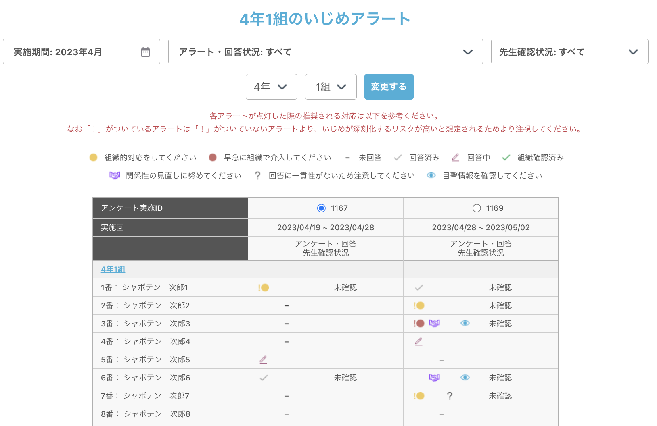
Figure 2 Teacher Dashboard
Notes:
This is a teacher dashboard. However, this is the Japanese version, so in the next slide, I will briefly show the English translation.

Slide 21

Figure 2 Teacher Dashboard
Students’ name | Survey 1 | Survey2 | Survey3…
1. Hiromichi Kato | ● | ✓ | ●！
2. Shu Yue |  | ● | ✓
3. Aleš Bučar |  | ● | ✓
4. …. | ●！ | ✓
Note:
● Indicates that the student reported experiencing one or more types of bullying.
●! Indicates that the reported bullying includes a highly distressing form of
victimization, such as relational aggression, occurring more than once per week.
● Indicates that the yellow-level condition is met, and the victimization remains
unresolved.
●! Indicates that the victimization remains unresolved despite the student having
consulted a teacher, or that the victimization is unresolved etc.
✓ Resolved
Notes:
When students respond to the bullying survey on their tablets, the result is instantly shared on a screen like this.
Each alert assesses the severity of bullying, with high-risk and currently unresolved cases shown as red alerts.
This screen is accessible to all teachers at the school.
I suffer from severe victimization.
Click the alert like this.
Teachers can access more detailed information by clicking on the alert.

Slide 22
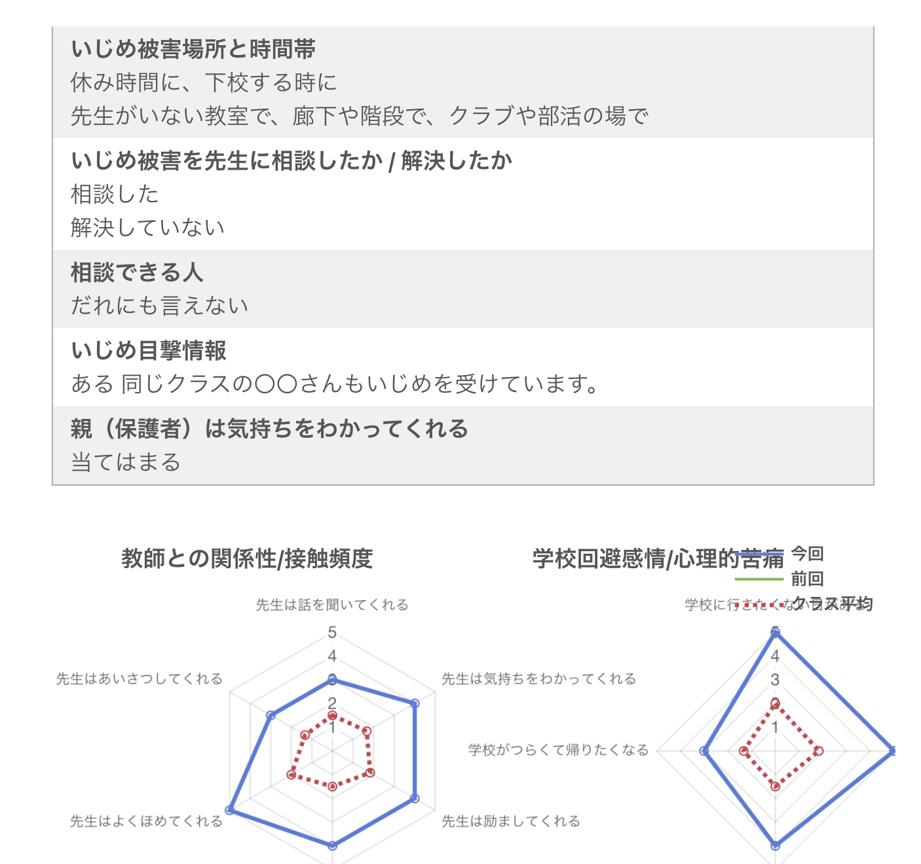
Figure 3 Detailed Information on the Teacher Interface
Notes:
This is also the Japanese version, so the next slide will briefly show the content in English.

Slide 23
●！
Name: Hiromichi Kato
Class 7-1, Student number 7
Date 20th May 2025
Type of victimization:
Be severely physically attacked- Several times a week
Time and Place of Bullying Incidents
During break time
In classrooms without teacher supervision
Did you ask a teacher for help about the bullying? / Was it resolved?
Talked to a teacher
Not resolved
Notes:
Through this screen teachers can confirm the type of victimization and time and place of bullying incidents and the state of solution.
At one middle school, using this app, students completed the survey in the morning when they arrived at school.
Teachers reviewed the results during the lunch break and intervened in the afternoon.
For example, if a report indicated bullying occurred in an unsupervised classroom during break time, the school responded by assigning multiple teachers to that classroom or having teachers proactively engage with the students involved.

Slide 24
Notes:
As a result, the incidence of bullying followed this trend.
All grade levels showed a tendency toward decreased bullying.

Slide 25
Notes:
Along with the decrease in bullying incidents, the frequency of teacher-student interactions increased.
In other words, using the app caused teachers to increase their interactions with students, which likely contributed to decreased bullying.

Slide 26
Conclusion
Impact of Introducing the App
1. It significantly reduced the time teachers spent
collecting, entering, and analyzing paper-based surveys.
2. Significantly reduced the time from survey to
Intervention in school.
3. More teacher-student interaction led to reduced bullying.
Notes:
Our application significantly reduced the time required for collecting, entering, and analyzing paper-based surveys.
This significantly reduced the time from the survey to the intervention.
This has helped reduce cases where individual teachers overlooked or underestimated bullying.
As a result, the frequency of interactions between teachers and students increased, reducing bullying victimization.
However, this is one example. We should then examine the app's effectiveness in more schools and improve it by listening to the voices of teachers and students.
That concludes my presentation.

Slide 27
Thank you for your attention. katou@edu.hokudai.ac.jp joetsu_work@icloud.com

Slide 28

Bullying prevention and intervention in Croatia: existing approach with a plan of an upgrade with the “With Knowledge against Bullying” project
Alma Rovis Brandić, senior advisor for preventive programs

Slide 29
ETTA
preventive policy, experiences and room for improvement
A plan of an upgrade with the “With Knowledge against Bullying” project
Preventive programs implemented by ETTA

Slide 30
ETTA network in prevention
ETTA – one senior advisor
- 32 heads of county expert councils for preventive programs
each school must appoint a person in charge of preventive programs
implementation of preventive policies

Slide 31
regulations
Zakon o odgoju i obrazovanju u osnovnoj i srednjoj školi (NN 87/08, 86/09, 92/10, 105/10, 90/11, 5/12, 16/12, 86/12, 126/12, 94/13, 152/14, 07/17, 68/18, 98/19, 64/20)
Pravilnik o načinu postupanja odgojno-obrazovnih radnika školskih ustanova u poduzimanju mjera zaštite prava učenika te prijave svakog kršenja tih prava nadležnim tijelima (NN, br. 132/13)
Pravilnik o kriterijima za izricanje pedagoških mjera (NN, 94/15, 3/17)
Pravilnik o tjednim radnim obvezama učitelja i stručnih suradnika u osnovnoj školi (NN, 34/14, 40/14, 103/14 i 102/19)
Protocol on handling in case of violence, 2024.
National education development plan the period up to 2027. and Action plan

Slide 32

What we don't see?
Self-harm
defiance
suicide threats
quarrel
absence from school
violence
What we see?
perfectionism
reticence
addictive behaviors
unrest
forms of behavior
risks in the environment
problems in the family
poverty
not/belonging to
lack of love
32
risk factors
abuse
fears
insecurity, problem with self-image
Notes:
32

Slide 33
which student behaviors are a problem?
Externalized forms of behavioral problems
Internalized forms of behavioral problems
for example excessive timidity, tearfulness, seclusion, depression, carelessness, addictive behaviors, self-harm, suicidality....
for example intrusiveness, defiance, lying, disobedience, opposing authorities, violent behavior, disobeying rules, regulations, promiscuous behavior..
BEHAVIORS THAT ARE EXCESSIVELY CONTROLLING AND SELF-DIRECTED
INSUFFICIENTLY CONTROLLED AND OTHER-DIRECTED BEHAVIORS
In recent years, it has been popular to call them mental health problems

Slide 34

all primary school students,
research ETTA 2015-17.
20 %
students with behavioral problems in regular elementary schools

Slide 35
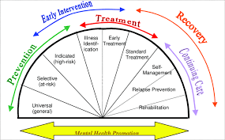

Spectrum of intervention
Mrazek i Haggerty, 1994.
2-3%
help from external institutions is needed
13 % students
school counselors
(professional associates) task
It is basically the (class) teacher's job.

Slide 36
Preventive policies of ETTA / AZOO
unfortunately, teachers do not acquire competencies for preventive work during their studies, that then remains the task of lifelong learning
ETTA also deals with this
We want evidence-based prevention programs to be avialable to schools.
We train trainers in various regions for preventive programs.
Every year the Ministry of Education sends a public invitation to schools through which it finances the introduction of preventive programs in schools, and the schools choose the one that suits them best.

Slide 37

Preventive programs implemented by ETTA
Preeschool
RESCUR: on the vaves, resiliense curriculum
Let's grow together, AZOO supports,
implemented by NGO
Mental health protection programs:
- PoMoZiDa (HelpTo)
- 5c pukotine (Cracks)
- Promehs curriculum
Primary school:
RESCUR: on the vaves
Lions quet Skills for adolescence, SEL (UNODC)
Unplagged, addiction prevention
Life skills training (according to Botvin) - Institute
for Public Healt, AZOO support
Tools for modern times, prevention of behavioral addictions (ERF)
The development of social self-image
SNEP junior- prevention of sexual violence
Secundary school:
Who actually wins? prevention of gambling and betting (ERF)
Lions quest – Skills for action SEL (UNODC)
Violence in youth relationships
SNEP – prevention of sexual violence
Who is that in the mirror?

Slide 38

support for teachers in protecting their mental health
Are you ok?
4 modules focused on prevention of burnout at work, easier handling of stress and preservation of mental health
In 2024 it participated 1.776 teachers
The evaluation score is 4.95 (out of a maximum of 5)
In 2025. until now, it participated 911 teachers in 2 moduls
The evaluation score is 4.89 (out of a maximum of 5)
Notes:
the lecturers were top Croatian experts in the field

Slide 39

Alphabet of prevention
support for schools to standardize the quality and content of school preventive strategies
development of a sustainable system of support for teachers in planning implementation of school preventive strategies
conducted by class teachers, with the support of professional associates
▪ standardization of prevention practices in Croatian schools
support of the principal and parents
three guides were created: 1st-4th grade, 5th-8th grade and high school
we started this school year, we are currently piloting

Slide 40
Primary school – specific goals
5 activities were developed for each specific goal for each class
development of self-esteem and positive self-image
development of collaborative social skills
development of non-violent conflict resolution skills
Two short professional lectures for parents were prepared for each class; PPTs were created
Notes:
A class mini-project can be developed from each activity or specific goal, a poster can be made and presented to parents, parents can be suggested to support the learned skill in a family context, a class or school theme of the month can be created, a preventive program for the class/school...

Slide 41
Secundary school - specific goals
minimum 2 (3) activities lasting 30/45 minutes in each semester; 36 activities were created
development of self-esteem and positive self-image
development of social-emotional skills
Two short professional lectures for parents were prepared for each class; PPTs were created

Slide 42

There is an opportunity and a need for a quality prevention program focused primarily on violence prevention.

Slide 43
A plan of an upgrade with the “With Knowledge against Bullying” project
In school
additional activities (e.g. day celebration, project day, integrated day
embedding the program into school documents at the beginning of the school year
carrying out all preparated workshops in the 3 final grades
regular cooperation with external institutions

Slide 44
Cooperation with external institutions
Education for teachers and parents; psychotherapy help
School
Family center
Community servis center
Police
Institut for social welfare
Mobil teams, help for families in need
Cooperaton in cases of violence
Cooperation in cases of violence
Notes:
mobile teams, help for families in need

Slide 45




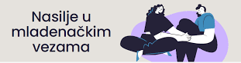


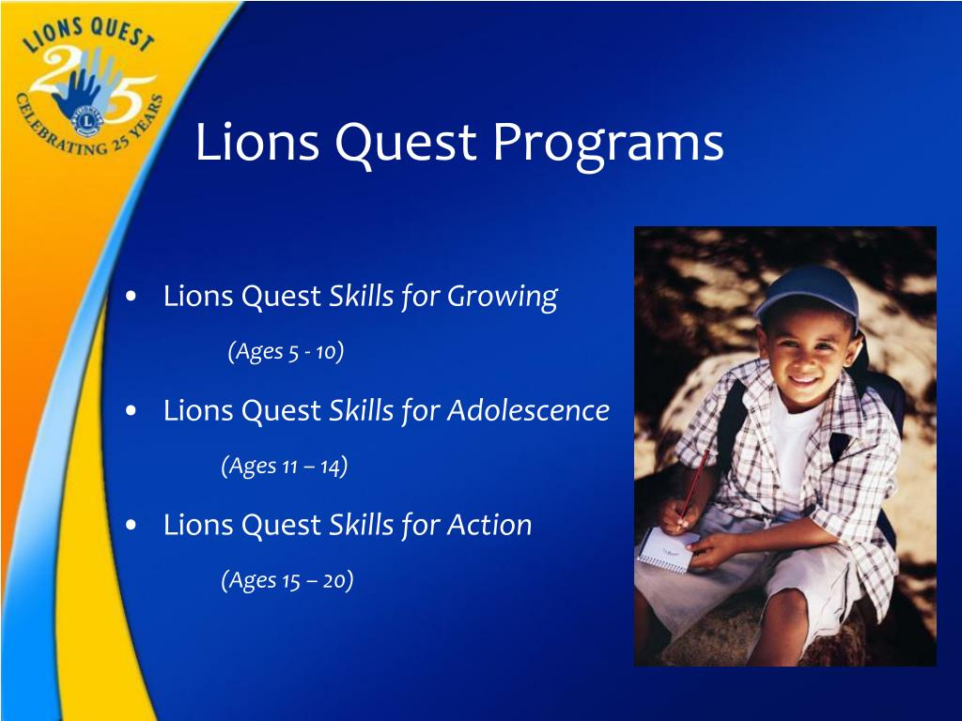

After piloting the program, we want to train trainers and make program With Knowledge against Bullying available to schools.

Slide 46


Slide 47
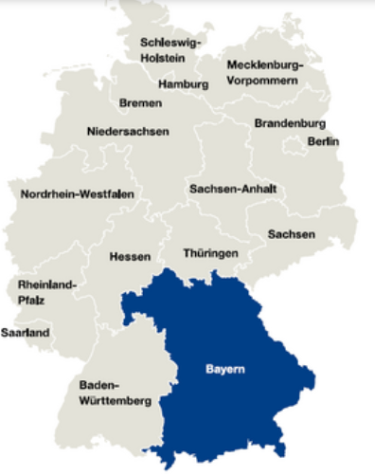
Preventing peer violence and ensuring quality in school environment:
German/Bavarian perspective
Margit Schmidbauer
Quality Agency/The Institute for School Quality and Educational Research (Germany/Bavaria)
Ljubljana, 21/5/2025
Notes:
Bavaria is one of the 16 states of the Federal Republic of Germany and is located in the southeast of the country. It is the largest state in Germany by area and, with approximately 13.4 million inhabitants, the second most populous state in Germany. The state capital and most populous city is Munich, with over 1.5 million inhabitants.

Slide 48
Bavaria: Prevention and intervention of bullying
Ministry of Education
schools
Ministry of Science
Common strategy for the prevention and intervention of bullying
Notes:
Bavaria's Ministry of Education and Science and the schools work hand in hand to prevent and intervene against bullying. The basis is a strategy whose instruments are networked at different levels and which contains a variety of measures. The focus lies on strengthening young people's self- and social skills.

Slide 49
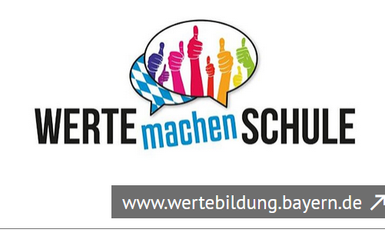
Contents
Values education portal (ISB)
→ Curriculum/LehrplanPlus
→ Values-based school development
→ Handouts and information material
→ Prevention programs and projects
→ Forms of networking and cooperation
Standards of the Quality Tableau/external school evaluation
Aims of the nationwide „Startchancenprogramm“

Slide 50

Values education portal (ISB)
Curriculum/LehrplanPlus
Main and upbringing goals → Bavarian constitution:
(1) Schools should not only impart knowledge and skills, but also develop heart and character.
(2) The primary educational goals are reverence for God, respect for religious beliefs and human dignity, self-control, a sense of responsibility and willingness to take responsibility, willingness to help, openness to everything that is true, good and beautiful and a sense of responsibility for nature and the environment.
(3) The students are to be educated in the spirit of democracy, in love for the Bavarian homeland and the German people and in the spirit of international reconciliation.
Notes:
The basis of the work of all Bavarian teachers is the main educational goals anchored in the Bavarian constitution (Art. 131 BayVerf):
It becomes clear that values ​​represent the foundation of our free, democratic society and that values ​​education in the sense of the highest educational goals is a primary task of school education.

Slide 51
Values education portal (ISB)
Curriculum/LehrplanPlus
Interdisciplinary goals: Value education
The students encounter the diversity of meaning and values ​​in an open and globalized society. They deal with the different answers to questions of meaning in order to find their own, reflected values ​​in political, religious and social contexts.
The Christian view of humanity and the educational goals derived from it are the basis and guiding perspective for respect for life and human dignity. The students respect different beliefs and act open-minded and tolerant in a plural society.
Notes:
In CurriculumPLUS there is a focus on values ​​education in many areas.
In addition to 14 other core goals, values ​​education is anchored in the curriculum as a cross-school and interdisciplinary educational goal.

Slide 52
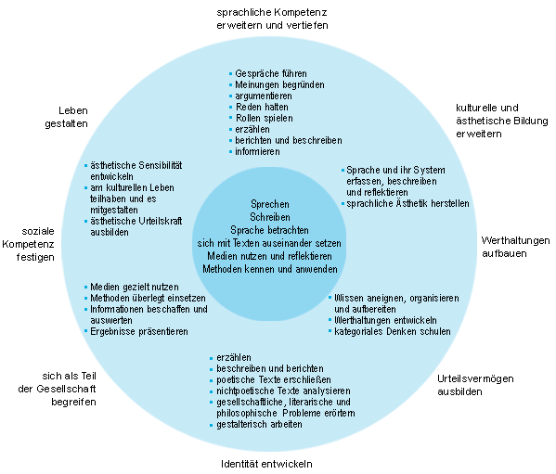
Values education portal (ISB)
Curriculum/LehrplanPlus
Subject-specific goals
In the individual subject profiles of the subjects in the different types of schools, values ​​education is also explicitly mentioned in many cases.
https://www.wertebildung.bayern.de/
Notes:
This makes it clear that values ​​education is an integral part of teaching in all subjects, especially when social or ethical issues are involved.
The detailed explanations of the curriculum contain a number of other examples of how the individual subjects are interconnected with values ​​education.

Slide 53
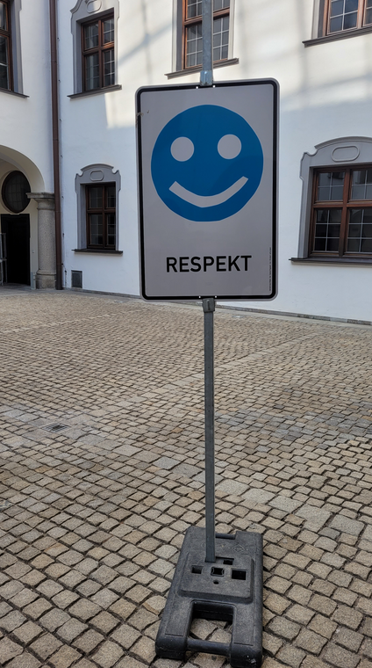
Values education portal (ISB)
Values-based school development
Value multipliers:
Part of the “Values ​​Make You Strong”- initiative (2008),
more than 120 teachers, support of interested teachers and schools in values ​​education
Values ​​ambassadors:
Since 2018: More direct involvement of students,
part of the “Values ​​Make Schools” initiative, values ambassadors are trained who actively help shape the value-building measures in their schools.
Notes:
Focusing on the elements of a values-based school development the following aspects are crucial:
Values-based school development processes
Values-oriented leadership
Teacher-personality and values

Slide 54
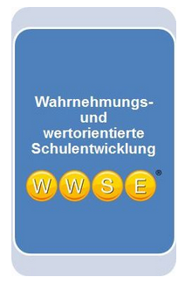
Values education portal (ISB)
Values-based school development
Support from WWSE – perception and values-oriented school development
Service package for schools and other educational institutions that primarily supports internal evaluation, empirically proven and continually further developed questionnaires

Slide 55
Values education portal (ISB)
Values-based school development
Values ​​education in teacher training courses:
University seminar dealing with “Values ​​Education as a Teaching Basis”
Values ​​education in the traineeship/seminar training:
Values ​​day is intended for trainee teachers and teacher trainees to provide an introduction to values ​​education
Values ​​education in teaching: Two-day online training (for teachers and school social educators) provides an introduction to values ​​education
Notes:
Further training initiative

Slide 56
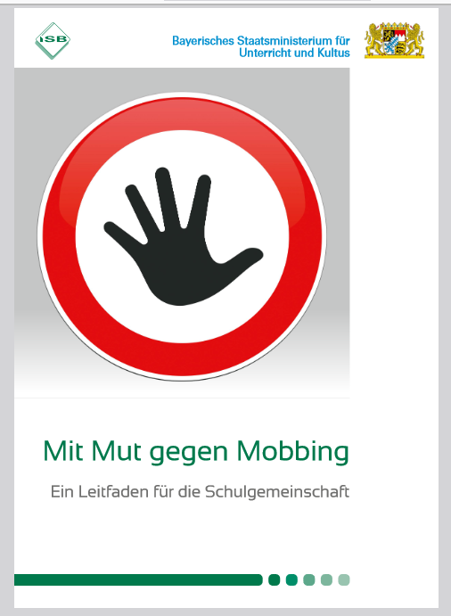
Values education portal (ISB)
Handouts and information material
ISB: Practical guide on the Bavarian state program
“With courage against bullying” (2020)
Information and strategies for action on the topic of bullying
Notes:
serves as initial information for schools and aims to encourage teachers of all types of schools to address the issue of bullying
The updated and expanded new edition of the handout “With courage against bullying” stands for professional action at school in both preventive and interventional areas. The aim should be to look sensitively, to counter bullying decisively and actively and at the same time to combine this with values ​​education, teaching life skills and behavioral training.
The brochure provides basic information on the subject of bullying, points out support offers within the school and across schools and presents concrete measures and methods of prevention and intervention.
Another focus is in the area of ​​school development. Examples of suggestions for implementing bullying prevention and bullying intervention in schools are presented for both teachers and school management.
The appendix provides templates that can be used as discussion guides and for documentation in cases of bullying. Reference is also made to materials available on the Internet and further literature on the subject of bullying.

Slide 57

Values education portal (ISB)
Prevention programs and projects
At student level, these include for example: values ​​education,
At class level: Programs such as „Prevention in the team (PIT), Faustlos, Lions Quest, TEAMGEISTER, Eigenständig werden (both primary school), „Aufg‘schaut“ (GS) and „Zammgrauft“ (MS) of the Munich Police Headquarter
Notes:
As a component of lessons and as a supplement to them, Bavarian schools have access to a variety of national and regional prevention programs - i.e. programs that promote social interaction. In these prevention programs - under the active guidance of the class teacher - the class community is promoted, among other things, through group dynamic units. Getting to know each other, mutual acceptance and recognizing the added value of diversity in a class group is supported right from the start, before unfavorable dynamics can even arise in the test phase of group formation.
In this context, it is also important to convey to children and young people that it is not about being friends with all their classmates, but rather about treating each other with respect.
FAUSTLOS is the German version of the US program “Second Step”, which was developed by the Committee for Children in Seattle and has been successfully used in many American states for around eight years. It was adapted for German-speaking countries by the “Children and Violence” project (Heidelberg Prevention Center). A large number of studies demonstrate the violence-preventing and social skills-promoting effect of the curriculum for daycare centers, kindergartens and primary schools. The studies show that through Faustlos (or Second Step), children become more empathetic and socially competent, can solve problems more effectively and are less likely to react physically or verbally aggressively. https://www.h-p-z.de/
Both “TEAM SPIRITS” and “Becoming Independent” are universal programs for social and emotional learning in the GS area and extend over the first four years of school. Each unit takes place in three steps: the children are activated with specific tasks, they exchange ideas with each other and finally these experiences are reflected on. Among other things, units on diversity, community, dealing with conflicts, etc. are worked on and thus actively strengthen life skills. The teachers are trained externally for these programs.
https://www.schule-in-bayern.de/post/sociales-miteinander-staerken-r-aber-wier
The “TEAMGEISTER” program was evaluated with very positive results in terms of its effectiveness

Slide 58
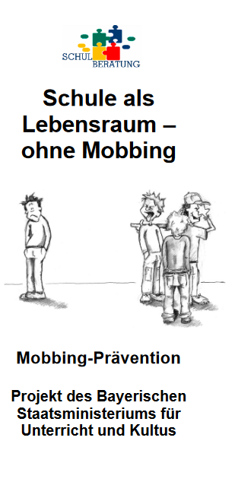
Values education portal (ISB)
Prevention programs and projects
At school level:
Initiatives such as
Streitschlichter (for students of elementary schools)
Since 2010:
Teacher training project “School as a living space – without bullying!” carried out nationwide by around 120 multipliers in close cooperation with the state school counseling centers.
Notes:
Streitschlichter: This program designed for elementary school involves specially trained students mediating between classmates and helping to resolve conflicts peacefully. They serve as neutral mediators and support children in resolving their own conflicts. Mediators are often a small group of specially trained students. Students can call on them if they need help with a dispute. Mediation usually takes place in a private room, where the disputants and the mediator work together to find a solution. The mediator guides the process, listens, asks questions, and helps the disputants understand their interests and work together to find a solution.
Schools are enabled by advisory teachers and school psychologists to deal with this topic independently and competently.

Slide 59
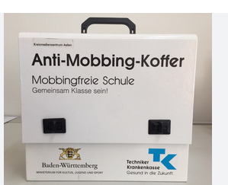
Values education portal (ISB)
Prevention programs and projects
Since 2011:
Prevention project “Bullying-free school – be class together!” (for secondary schools, grades 5-7)
Cooperation between the Bavarian Ministry of Education and the Techniker Krankenkasse (TK).
Materials available free of charge on a digital platform.
Notes:
Since 2011 “Bullying-free school – being class together”. The platform is the successor to the anti-bullying case that the two project partners have been using since 2011.
25 coordinators from the Bavarian school counseling centers have now been trained in how to use the online modules. There are also 173 multipliers. They impart their knowledge to teachers from interested schools. The aim is to acquire professional and pedagogical expertise in the fight against bullying. After the training, schools receive an access code to the platform and can use the free materials to design up to five project days on the topic of bullying. The students train, among other things, in role plays how to interact with each other positively and constructively. Various films show the consequences bullying has for those affected. Together with the teachers, the children and young people work out what they can do to protect themselves and prevent bullying from occurring in the first place. In addition, legal principles and the meaning of simply watching and thus tacitly accepting things are examined. The difference between conflict and bullying is also an issue.

Slide 60
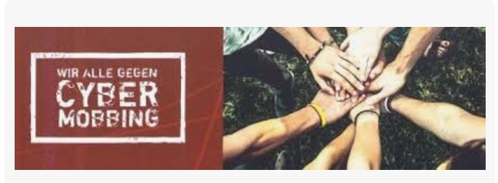
Values education portal (ISB)
Prevention programs and projects
Since 2023:
Prevention program “We all against cyberbullying”, educational events, project work and parents' evenings at schools as a cooperation between the Bavarian company health insurance companies (BKK) and the Alliance against Cyberbullying.
Notes:
Together with students, parents and teachers, strategies are developed to identify cyberbullying at an early stage and combat it effectively.
An evaluation of those who have taken part in the prevention program so far results in a wealth of positive feedback: The majority of parents, students and teachers rate the information and content provided as very helpful for dealing with bullying on the web.

Slide 61

Networking and cooperation
School psychologists and counseling teachers:
First trusted contacts for students and their legal guardians
In addition, every administrative district has at least one state school counseling center:
Particularly experienced school psychologists and advisory teachers
Notes:
In addition to teachers, school psychologists and counseling teachers serve as the first trusted contacts for students and their legal guardians - e.g. B. in incidents involving violence and bullying.
In addition, every administrative district has at least one state school counseling center. Here, particularly experienced school psychologists and advisory teachers are available to answer questions and solve problems in a school context.

Slide 62


Networking and cooperation
Network of regional representatives for democracy and tolerance and the media education and information technology consultants (MiBs): Support for schools in their prevention work for democracy and tolerance as well as in the correct use of media
Liaison teachers and, if necessary, specialists in youth social work at schools (JaS)
Notes:
Schools are supported in their prevention work for democracy and tolerance as well as in the correct use of media by the network of regional representatives for democracy and tolerance and the media education and information technology consultants (MiBs).
Liaison teachers and, if necessary, specialists in youth social work at schools (JaS) are also helpful contacts.

Slide 63

Networking and cooperation
“School opens up” program:
School social pedagogues, as a newly developed professional group, support schools in the area of ​​values ​​and social education
(Handouts 1/2023 and 2/2024 from the ISB)

Slide 64
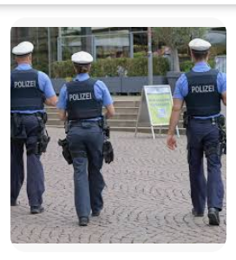
Classification of bullying and disciplinary measures
Variety of instruments from educational measures to regulatory measures and reporting to the police and public
Serious insults and cyberbullying must be reported as crimes
(announcement from the Ministry of Culture dated September 23, 2014)
Notes:
In order to prevent possible attacks or to counter them effectively, there are a variety of instruments that range from educational measures to regulatory measures and reporting to the police and public prosecutor's office.
In an announcement from the Ministry of Culture dated September 23, 2014, it was specifically pointed out that, for example: Serious insults and cyberbullying must be reported as crimes.

Slide 65
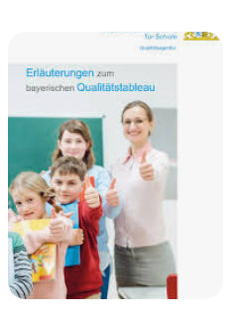
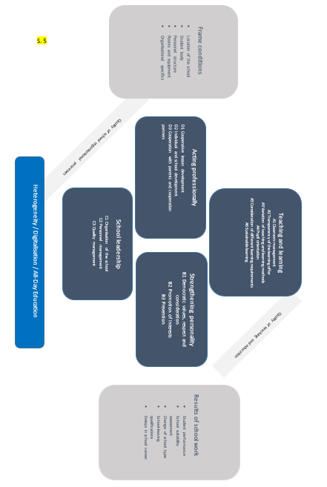
Standards of the Quality Tableau/external school evaluation
External evaluation: Concept and procedure are based on the Quality Tableau “Bavaria does schooling well” (2019), containing standards for good schools and good school education, serving as reference standard for assessment on requirements level
Notes:
External school evaluation in Bavaria has been carried out for the last more than 20 years mandatorily in an ideally five-years’-cycle and is currently about to be reconceptualized. However, the still valid concept and procedure is based on the quality tableau “Bavaria does schooling well” that contains standards for schools and school education. These standards form the basis for the methods and instruments used and serve as a reference standard for the assessments awarded at requirements level.

Slide 66
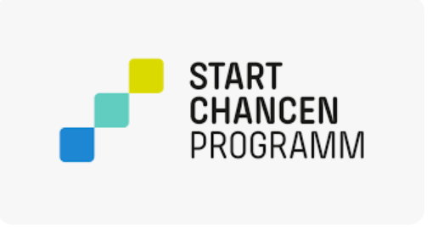
Aims of the nationwide „Startchancenprogramm“
2024/25: Largest educational program in the history of the Federal Republic of Germany, decoupling educational success from social background:
Halvening the number of students who fail to meet the minimum standards of basic skills (reading, writing and arithmetic), increasing socio-emotional skills
Notes:
The Startchancen program was introduced for the 2024/25 school year and will run for ten years. It is the largest educational program in the history of the Federal Republic of Germany. The federal and state governments are investing a total of approximately 20 billion euros in it over ten years. Approximately 4,000 schools with a high proportion of socially disadvantaged students will receive targeted support through the Startchancen program.
Aim to decouple educational success from social background, to ensure greater equality of opportunity
Strengthening basic skills such as reading, writing, and arithmetic and to halve the number of students who fail to meet the minimum standards in mathematics and German at the Startchancen schools by the end of the program
Another focus on personal development of the students
Since the Startchancenprogramm requires the use of a social index, the Free State of Bavaria aimed to capture the socioeconomic conditions in the state as accurately as possible and therefore takes into account the following five indicators which are crucial with regard to setting a basis for the development of anti-social behavior of which bullying might be one form of:
Child poverty rate
Proportion of employees above the social assessment threshold
Proportion of children whose home language is not German
Proportion of children with migration experience (excluding origins from German-speaking countries)
Proportion of university graduates

Slide 67
Aims of the nationwide „Startchancenprogramm“
Bavaria: Significant increase in students' socio-emotional competencies as a necessary basis for developing basic skills in reading and arithmetic
Indicators, evaluation, data needed!
Notes:
The Startchancen program was introduced for the 2024/25 school year and will run for ten years. It is the largest educational program in the history of the Federal Republic of Germany. The federal and state governments are investing a total of approximately 20 billion euros in it over ten years. Approximately 4,000 schools with a high proportion of socially disadvantaged students will receive targeted support through the Startchancen program.
Aim to decouple educational success from social background, to ensure greater equality of opportunity
Strengthening basic skills such as reading, writing, and arithmetic and to halve the number of students who fail to meet the minimum standards in mathematics and German at the Startchancen schools by the end of the program
Another focus on personal development of the students
Since the Startchancenprogramm requires the use of a social index, the Free State of Bavaria aimed to capture the socioeconomic conditions in the state as accurately as possible and therefore takes into account the following five indicators which are crucial with regard to setting a basis for the development of anti-social behavior of which bullying might be one form of:
Child poverty rate
Proportion of employees above the social assessment threshold
Proportion of children whose home language is not German
Proportion of children with migration experience (excluding origins from German-speaking countries)
Proportion of university graduates

Slide 68

Bavaria: Prevention and intervention of bullying

Slide 69
BID MALMÖ
Collaboration as it’s best!
Milan Obradovic´ & Jeanette Berga , Malmö Sweden
Ljubljana, 21 may 2025, Erasmus+ project With Knowledge Against Bullying

Slide 70
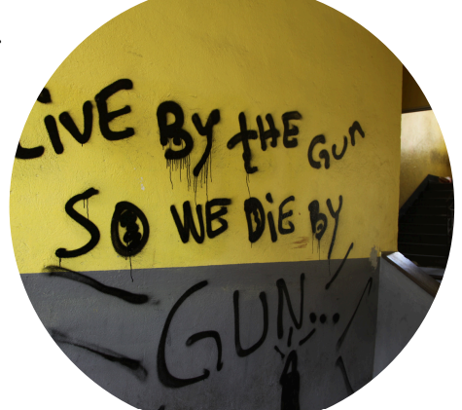
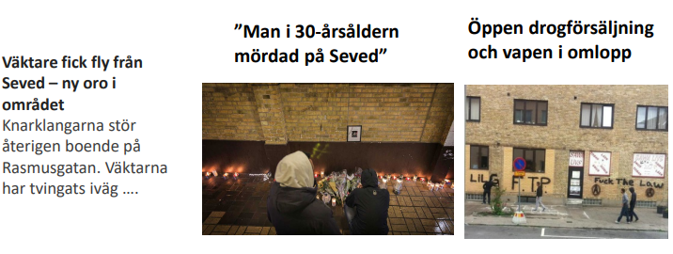
A particualry vulnerable area
In the city center of Malmö
Depraved area
Misery
Criminals had been taken over the area

Slide 71
BID start the process 2014
BID
NGO
Public- Privat - Colloboration
Geographically defined area
Solve the challenges together
NGO with property owners as board members
Financed by the members
The municipality are a member of the organization, but not as a board member.

Slide 72
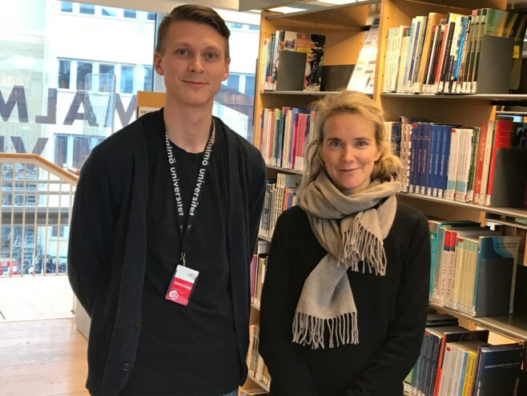

Evaluation is essential in process – oriented work
Researches has been following our work from start.
In our work, we base our approach on surveys, demographic data, police statistics and research theories on prevention.
Notes:
When working on developing an area in process like ours it is important to incorporate research or some form of evaluation. That is what we did from the beginning. For ten years professor Anna Karin Ivert at malmö university Faculty of criminology as studied our work together woth ere collegues.
There are books, and numerous articles have been written about our successful work.

Slide 73
European Crime Prevention Award
BID Sofielund is the winner of the European Crime Prevention Award (ECPA) 2019
The work is praised for broad crime prevention efforts in Sofielund with a focus on the particularly vulnerable area Sofielund/ Seved .which has led to increased well – being and stability in the area.
In second and third place were Germany & Denmark

Slide 74
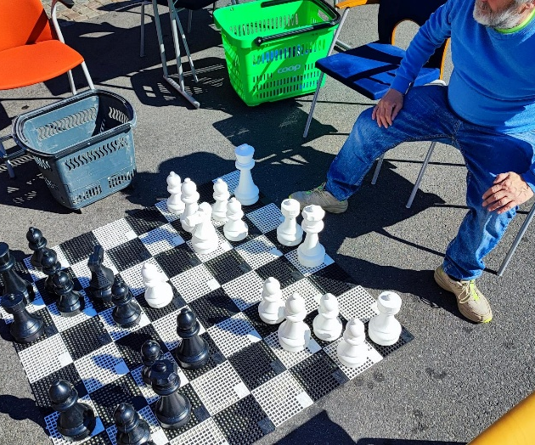
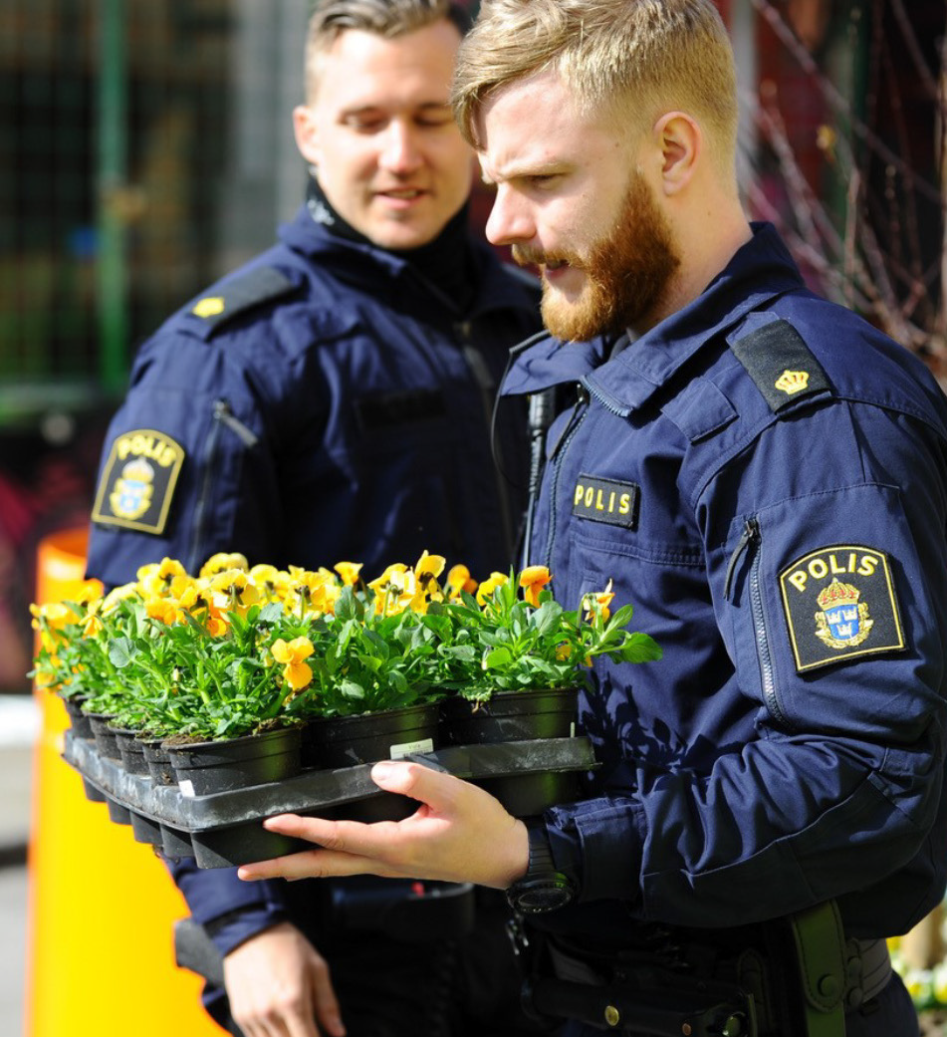
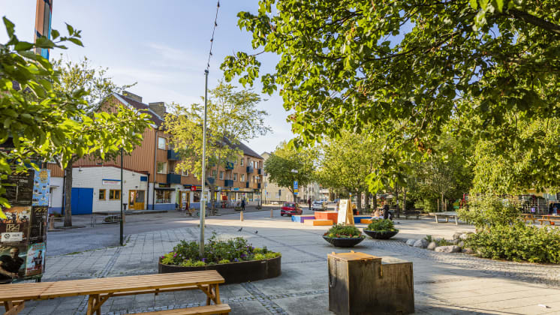
2023 and the ongoing process
Succeed to implement a process to develop an area.
Collaboration and transparency
Property owners
Responsibility
From now and forward
Sustainability – Agenda 2030

Slide 75

Thank You
Milan Obradovic´
Operational manager
Jeanette Berga
Organization developer
www.bidmalmo.se

Slide 76


The use of drama in bullying prevention
Mette Bøe Lyngstad
Professor in Drama and Applied Theatre. Western Norway University of Applied Sciences, Institute of Art.
Dziuginta Baraldsnes
Associate Professor, The Norwegian Centre for Learning Environment and Behavioural Research, University of Stavanger
Ljubljana, 21/5/2025
Notes:
And now I would like to briefly present the project «Drama and Bullying», which was conducted by me and Mette Bøe Lyngstad, who is a professor in Drama and Applied Theatreand she is with us today.

Slide 77
Introduction
‘The school should allow students to exude creative joy, dedication and exploration and give them experience in seeing opportunities and translating ideas into action’ (The Norwegian Directorate for Education and Training, 2020, 6).
‘Drama’ is action, and through fiction, students can experience, with their whole body, different perspectives on the phenomenon of bullying.
Notes:
The Norwegian Directorate for Education and Training underscored that …

Slide 78
Research questions
Which initiatives do Norwegian adolescents make use of in process drama as bullying prevention?
Which attitudes towards this kind of prevention work do they emphasise?
Notes:
We formulated two research questions to explore the use of drama in bullying prevention:

Slide 79

Process drama with students
Notes:
Now imagine that you are one of these students in the AI generated picture sitting in the circle in the classroom and waiting for the beginning of the class meeting. Here comes the teacher in role….

Slide 80
The drama workshop
The process drama:
‘The Event’ (Eriksson & Heggstad, 2002).
Teacher-in-role (Heathcote & Bolton, 1995),
‘Writing in Role’ (Neelands & Goode, 2015),
Voices in the Head (Neelands & Goode 2015).
Theatrical forms:
Image Theatre (Boal 1992);
Active Assessment exercises, inspired by Byréus (2010).
Notes:
Mette

Slide 81
Research Project Drama & Bullying
(2017–2020)
Place: The west coast of Norway.
Participants: 95 (45 males) students who were 15 or 16 years of age and from four different classes in one secondary school participated in this case study.
Research methods:
(a) process drama,
(b) structured observation,
(c) survey consisting of five open-ended questions.
Involvement of two of the researchers in the project: facilitator and observer.
Notes:
We conducted our project in four classes in one secondary school, where 95 students in total participated. Two researchers – Mette and I – were involved, where Mette took a role as facilitator of process drama, and I was responsible for structured observation and data collection by conducting a short survey.

Slide 82
Project’s outcomes
The feedback from the students showed that this form of process drama can give us a deeper insight into the specificity of bullying and cyberbullying and the possibilities for preventing and intervening in it.
In role as teachers in the staff meeting, the students came up with several initiatives and ways of reacting to bullying:
interact with students: listen to them and react to their behaviour;
make the school safer: have more guards, open the school hall for safe play, observe the students more, take away students' telephones;
involve other parties such as police and parents, and even other colleagues that you can collaborate with.

Slide 83
Project’s outcomes
Regarding the attitudes towards this type of preventive work, we found that the participants’ input can be gathered in three main themes:
  fiction as protection,
  taking different perspectives,
  in-depth understanding of the situation.
The students indicated that process drama is a more engaging way of learning about sensitive and difficult issues than ordinary classroom lectures are.

Slide 84

Letters from students to Steven:
‘Hi Steven. It is sad what happened to you, and I hope you’ll be well as soon as possible’.
‘When you come back, I hope we can become friends.’
‘Steven, you seemed to be a good friend, so I’d love to get to know you better’.
‘Dear Steven, I have been thinking about you! We are all here to support you. You are not alone. I am looking forward to your recovery and seeing you come back to school’.
‘Dear Steven! I hope you are getting better/…/ I can come to visit you and bring your books to
‘I would have helped you if I had known what was happening to you at that time’.
Notes:
Here we would like to present some examples from letters from students to Steven. As you can see, the majority of students expressed empathy along with good wishes to Steven, and whish to take care of him or help him. If you want to get more detailed information about the project and outcomes, please, use the provided link and read our article.

Slide 85
Thank you for your attention!
Process drama in anti-bullying intervention: a study of adolescents’ attitudes and initiatives: Research in Drama Education: The Journal of Applied Theatre and Performance: Vol 27 , No 4 - Get Access
Notes:
Thank you for your attention, and we hope that there will be MORE Drama in Schools, as some students mentioned in filling out the Survey.

Slide 86
RAZPRAVA

Slide 87
